Slide 1

Synthwave Music
making
with
Functional Programming
2023 Hyland Hackathon
Notes:
Hello and welcome to the Programming Synthwave Music Session!

Slide 2
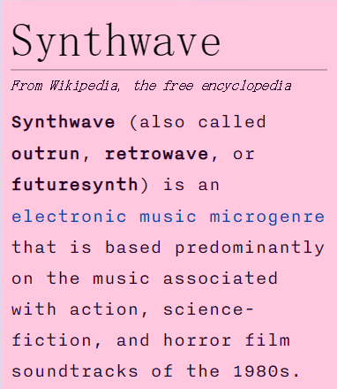



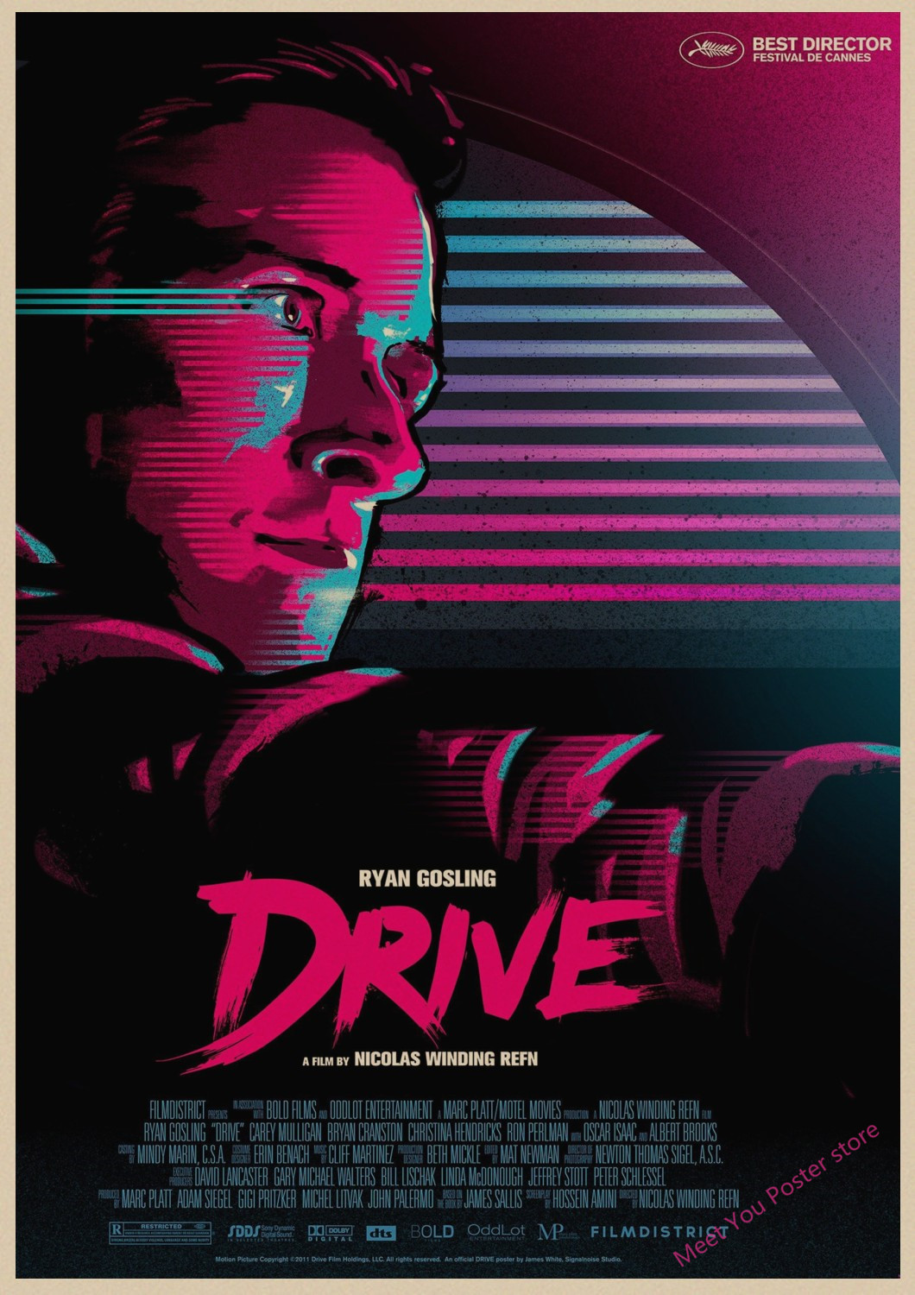
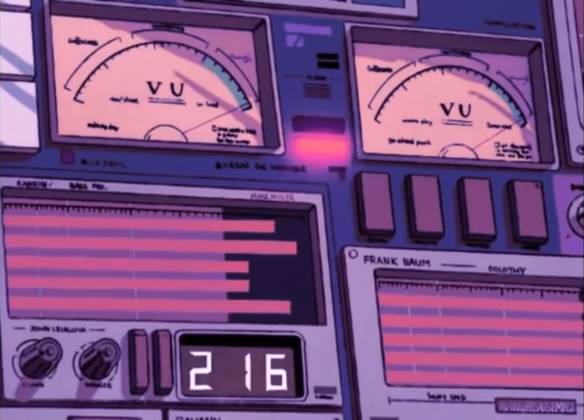



What Is Synthwave?
Programming Synthwave Music | 2023 Hyland Hackathon
Notes:
Has anyone heard of Synthwave before?
Here’s the definition from Wikipedia. Synthwave is a microgenre of electronica that relies on a heavy use of synthesizers and draws on 1980s nostalgia.
If you’ve ever watched Stranger Things, the theme song is synthwave.
The 2011 film Drive featured several synthwave tracks, and helped expand the genre.
In addition to audio, synthwave has a distinctive retro aesthetic. Pulling from shows like Miami Vice and vintage anime, there are a lot of pinks and purples and cars and nights.
At this point, synthwave has truly entered the mainstream of modern pop – if you’ve ever heard the track Blinding Lights by The Weeknd, you should know that it’s synthwave!
Here’s a short clip from that track. So now you know what synthwave is, but…

Slide 3

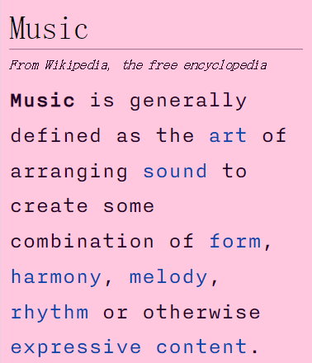
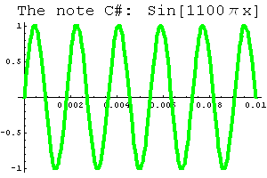
What Is Music?
Tempo: Speed
Note: Pitch + Time
Chord: Set of Notes
Major Chord: ☺
Minor Chord: ☹
Arpeggio: Sequence
Oscillator: Waveform Generator
LFO: Low Frequency Oscillator
Effects: Delay, Reverb, etc.
Sampler: Uses Existing Sounds
Programming Synthwave Music | 2023 Hyland Hackathon
Notes:
Can anyone tell me what music is?
Here is the Wikipedia definition of music. For our purposes, there will be a few things you might want to know before we jump into making some music.
The tempo of a track is the speed.
A note is a pitch and a time or duration.
A chord is a set of notes. We will use chords to create our piece.
In general, major chords are happy, and minor chords are sad. An arpeggio is a run through each note in a chord sequentially, as opposed to voicing all notes simultaneously. But how do we make music digitally?
We use these things called oscillators which generate waveforms. All sound is waves, and oscillators let us create some very basic notes.
Two examples of types of waves are the Sine wave and a Sawtooth wave.
An LFO is a low frequency oscillator – these are not used for pitches, but control other parameters, like…
Effects! These include things like delay or reverb. You’ve probably heard these effects in songs even if you don’t know what they are!
One last thing we will use is a sampler – it’s an instrument that lets us take sounds that already exist, and put them into our piece. If you’ve ever heard of a track “sampling” something (especially common in hip-hop), they are using something like a sampler! So we’re all set on music, but… how do we use programming to make it?

Slide 4
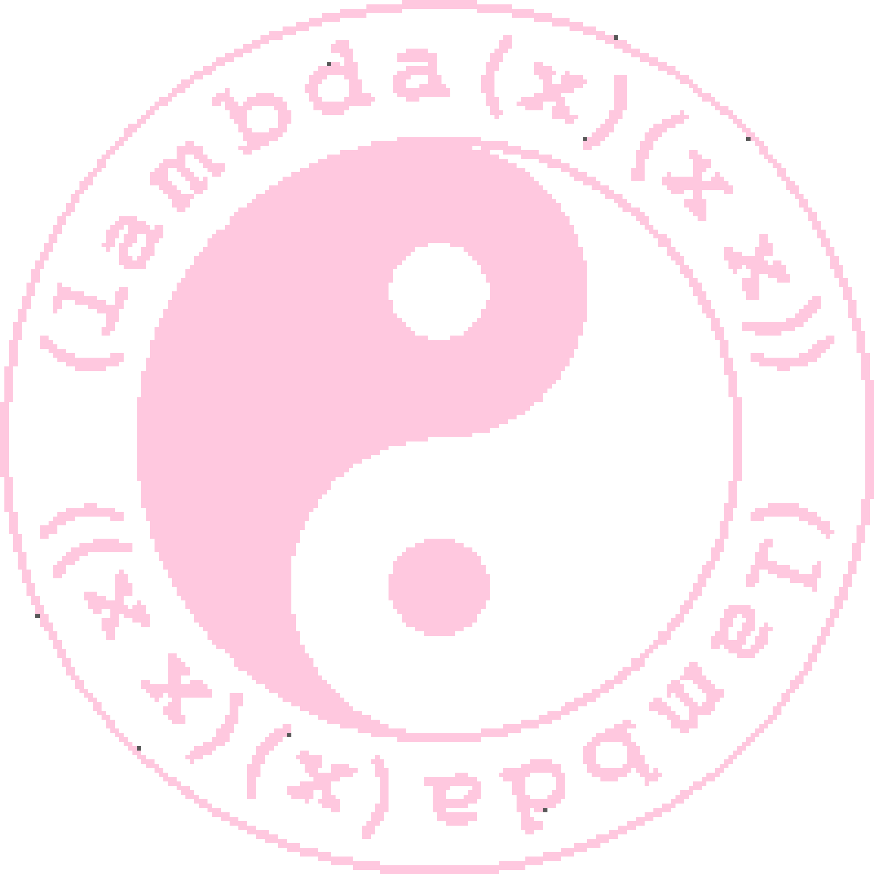
What Is Functional Programming?
A programming paradigm where everything is a function
As opposed to imperative programming
Languages
Haskell (pure)
Elm (pure)
JavaScript (impure)
Python (impure)
Lisp (mainly)
Scheme
Racket
Extempore
About
Lambda Calculus
Function Objects
No Side Effects
Recursion Use
Programming Synthwave Music | 2023 Hyland Hackathon
Notes:
Does anyone know what functional programming is?
It’s a programming paradigm where everything is a function. Everything is centered around functions. This can be very different than imperative programming, where everything executes line by line.
Let’s discuss some characteristics of functional programs. They are based on the Lambda Calculus – if you’ve ever used a “lambda” function, that’s where it gets its name! Functions can be passed as objects, and all objects can be considered functions. When you run a function, there is no mutation, no state, and no side effects – you only get output. Recursion is used heavily in the functional programming world.
Here are some examples of functional programming languages. Some are purely functional, but some just have functional components and can be used functionally. The last example here is Extempore – what’s that?

Slide 5


What Is Extempore?
Extempore is a programming language and runtime environment designed to support cyberphysical programming, where a human programmer operates as an active agent in the world.
(:> scale 4 0 (play syn1 @1 100 dur)
'(c4 d4 e4 f4 g4 a4 b4 c5))
Programming Synthwave Music | 2023 Hyland Hackathon
Notes:
Anyone know what Extempore is?
Extempore is a special programming environment that lets you interact with audio in a “live coding” context.
Here’s an example of some code. Anyone have any idea what this does? It plays a scale in the key of C Major!

Slide 6
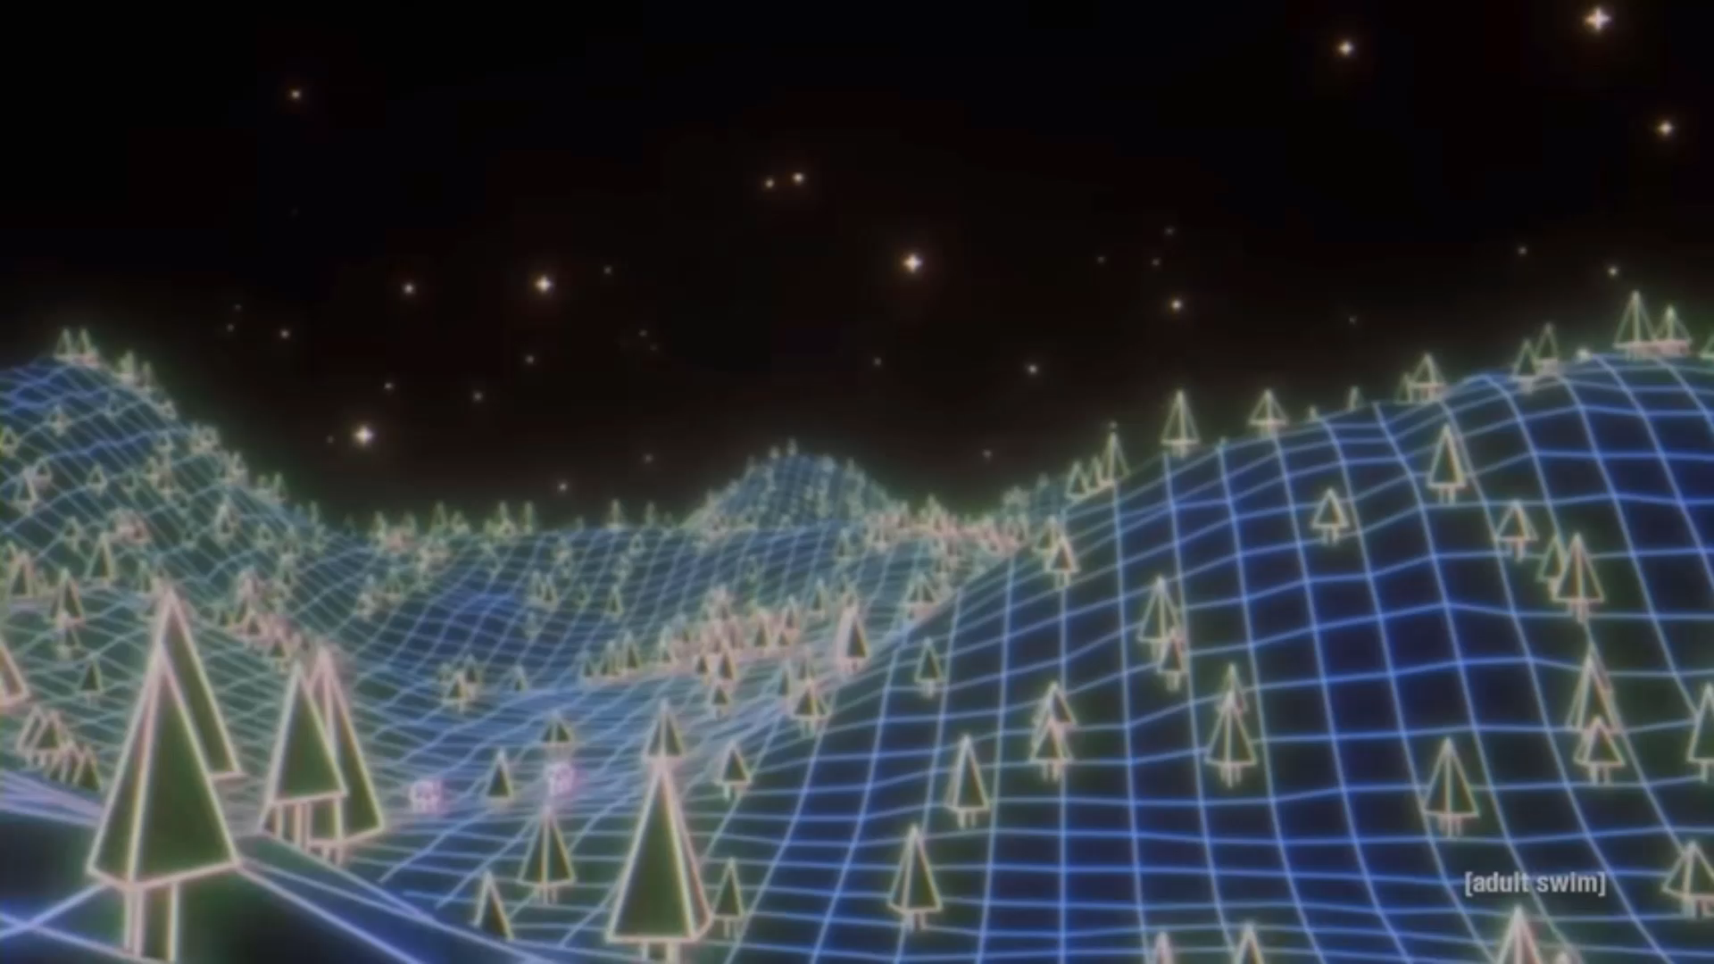
Questions?
Notes:
We will get more into the specifics soon, but does anyone have any questions at this time?

